Slide 1
GNF (Lemma 1 )
---Sakshi Surve

Slide 2
Normal Forms:
By reducing the grammar, the grammar gets minimized but does not get
standardized.
This is because the RHS of productions have no specific format.
In order to standardize the grammar, normalization is performed using
normal forms.

Slide 3
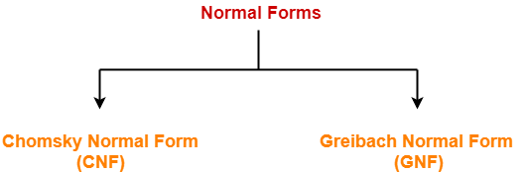

Slide 4
Greibach Normal Form (GNF) :
GNF stands for Greibach Normal Form.
A CFG(context free grammar) is in GNF(Greibach normal form) if all the production rules satisfy one of the following conditions:
A non-terminal generating a terminal.
A → a.
A non-terminal generating a terminal which is followed by any number of non-terminals.
S → aA.
A → bD₁…D_{n}

Slide 5
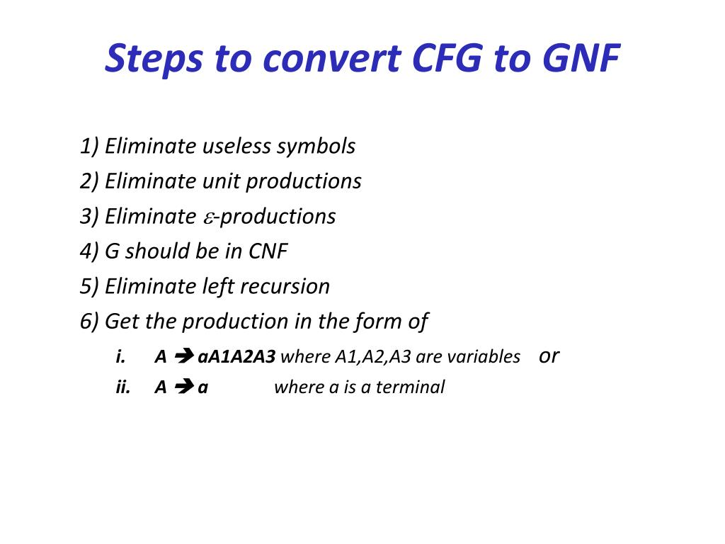

Slide 6
Lemma 1: Substitution Rule
If G is a grammar with productions
A → Ba
B → B₁ | B₂ | B₃ | …B_{n}
Then, the CFG can be converted to GNF as
A → B₁a | B₂a | …..B_{n}a

Slide 7
Lemma 2 : Removal of Left Recursion
This is applicable for removing Left Recursion present in the Grammar
A → Aa₁ | Aa₂ | Aa₃| ………| Aa_{n} |B₁ | B₂|…..B_{n}
Equivalent GNF will be :
A → B1 | B2 | B3…..| Bn
A → B1Z | B2Z | B3Z | …….Bn Z
Z → a1 | a2 | a3 ….. | an
Z → a1 Z| a2Z |a3Z |….|anZ

Slide 8
1. Find GNF of the grammar given below S→ ABA | AB | BA | AA | A | B A → aA | a B → bB | b
Simplifying the grammar and removing the Unit Productions …
S→ ABA | AB | BA | AA | aA | a | bB | b
A → aA | a
B → bB | b
A → aA | a …………. 1 in GNF
B → bB | b ………… 2 in GNF

Slide 9
S is not in GNF
Applying Substitutions of A and B in S as per Lemma 1 ..
S→ aABA | aBA | aAB | aB | bBA | bA | aAA | aA |
a | bB | b ………………. 3 in GNF
Hence, the new grammar G’ in GNF is :
G’ = { (S, A, B) , S , P, (a , b)}
P➔
S→ aABA | aBA | aAB | aB | bBA | bA | aAA | aA |
a | bB | b
A → aA | a
B → bB | b

Slide 10
2. Find GNF equivalent to given CFG S→ AB A→ aA | bB | b B → b
Step 1: Grammar is simplified
Step 2 : Checking for each production for GNF
B→ b …………….1 in GNF
A→ aA | bB | b ……………2 in GNF
S→ AB Not in GNF
Applying Lemma 1 , substituting all productions of A in S …we get,
S→ aAB | bBB | bB …………..3 in GNF

Slide 11
Hence, the new grammar G’ in GNF is :
G’ = { (S, A, B) , S , P, (a , b)}
P➔ S→ aAB | bBB | bB
A → aA | bB | b
B → b

Slide 12
3. Find GNF of the grammar given below S→ ABAb | ab B → ABA | a A → a | b
Considering each production and converting to GNF
A → a | b ……….. 1 in GNF
B→ ABA | a
Substituting A → a and A → b in above production using Lemma 1
B → aBA | bBA | a ………………… 2 is in GNF

Slide 13
For production S→ ABAb | ab
Introducing a non terminal C→b
S→ ABAC | aC
S→ aC ………...3 in GNF
S→ ABAC Not in GNF
Substituting productions of A in above production using Lemma 1 , we get
S → aBAC | bBAC …………. 4 in GNF

Slide 14
Hence, the new grammar G’ in GNF is :
G’ = { (S, A, B, C) , S , P, (a , b)}
P➔ S → aBAC | bBAC | aC
B → aBA | bBA| a
A → a | b
C → b

Slide 15
4. Find GNF of the grammar given below S→ XX1 | 0 X → 00X | Y Y → 1X1
Removing the Unit Production X→Y , the grammar becomes,
S→ XX1 | 0
X → 00X | 1X1
Introducing Non Terminals A→1 , and B→ 0
S→ XXA | 0
X → 0BX | 1XA
X→ 0BX | 1XA ……………..1 in GNF
A→1 …………… 2 in GNF
B→0 ……………. 3 in GNF

Slide 16
S→ XXA | 0 Not in GNF
Substituting productions of X in above production using Lemma 1 , we get
S → 0BXXA | 1XAXA | 0 ………. 3 in GNF
Hence, the new grammar G’ in GNF is :
G’ = { (S, A, B, C) , S , P, (a , b)}
P➔ S → 0BXXA | 1XAXA | 0
X→ 0BX | 1XA
A→ 1
B→0

Slide 17
5. Find GNF equivalent to given CFG S→ AB A→ BSB| BB | b B → aAb | a
Grammar is simplified
Add a new Non terminal C as C → b
G becomes
S → AB
A → BSB | BB | b
B → aAC | a
C → b

Slide 18
C → b ……….. 1 in GNF
B → aAC | a ………. 2 in GNF
A → BSB | BB …… Not in GNF
Substituting productions of B in above production using
Lemma 1 , we get…
A → aACSB | aSB | aACB | aB | b ……………. 3 in GNF
S → AB ….not in GNF
Substituting productions of A in above production using
Lemma 1 , we get…
S → aACSBB | aSBB | aACBB | aBB | bB ……… 4 in GNF

Slide 19
Hence, the new grammar G’ in GNF is :
G’ = { (S, A, B, C) , S , P, (a , b)}
P➔ S → aACSBB | aSBB | aACBB | aBB | bB
A → aACSB | aSB | aACB | aB | b
B → aAC | a
C → b

Slide 20
6. Find GNF equivalent to given CFG S→ AB A→ aBa| a B → aAb | b
C→ a, D→b
S→AB
A→aBC | a
B→ aAD | b
Final Productions :
S→ aBCB | aB
A→aBC | a
B→ aAD | b

